Slide 1
The Female Side of Suicide
Visualizing 30 Years of Global Suicide Patterns of Women
Kyle S. Mellors
MSDS 670 - Mid Term Project

Slide 2
Introduction
As a personal advocate of equality for all persons, I have taken this opportunity to look at the analysis of a taboo topic for a marginalized group: death by suicide of women.
Discussion on suicide statistics of men is very common, with most of us easily quoting statistics like “men are much more likely to commit suicide than women”. While these statistics are alarming - and need to be addressed - it is equally important we talk about suicide and women, who still face the same factors and consequences.
Additionally, we have all likely dealt with suicide, whether it be a friend, family, loved one, acquaintance, or an idol or celebrity.
My goal is to increase awareness of death by suicide rates for women. The numbers are not inconsequential and women can suffer from unique factors.
https://www.kaggle.com/datasets/russellyates88/suicide-rates-overview-1985-to-2016?select=master.csv

Slide 3
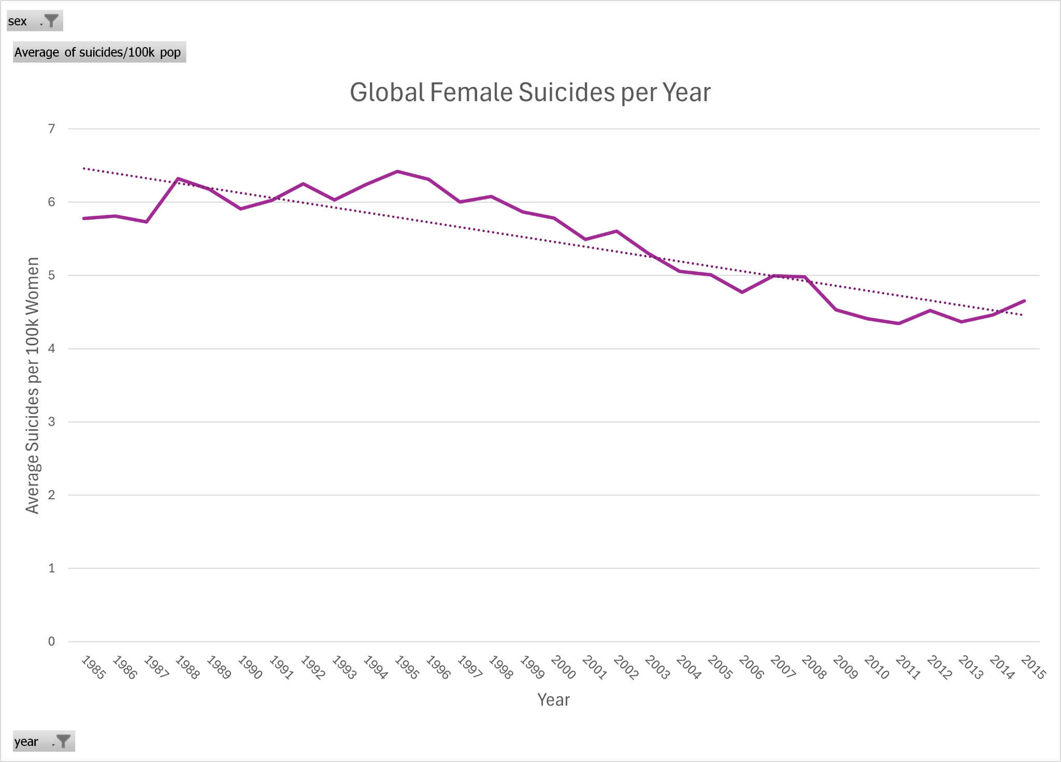
Women Suicide Rates From 1985-2015
Steady decline over the years. Nearly 6/100k in 1985 & <5/100k 2015.
Max point: 1995 (6.4)
Min Point: 2011 (4.4)
Reasons for this trend:
Increased QoL and Gender Equality[1]
Increased engagement in politics and leadership[1]
Increased resource allocation for female victims[2]
The gender gap still exists, but there are global trends showing the gap is closing.[3]

Slide 4
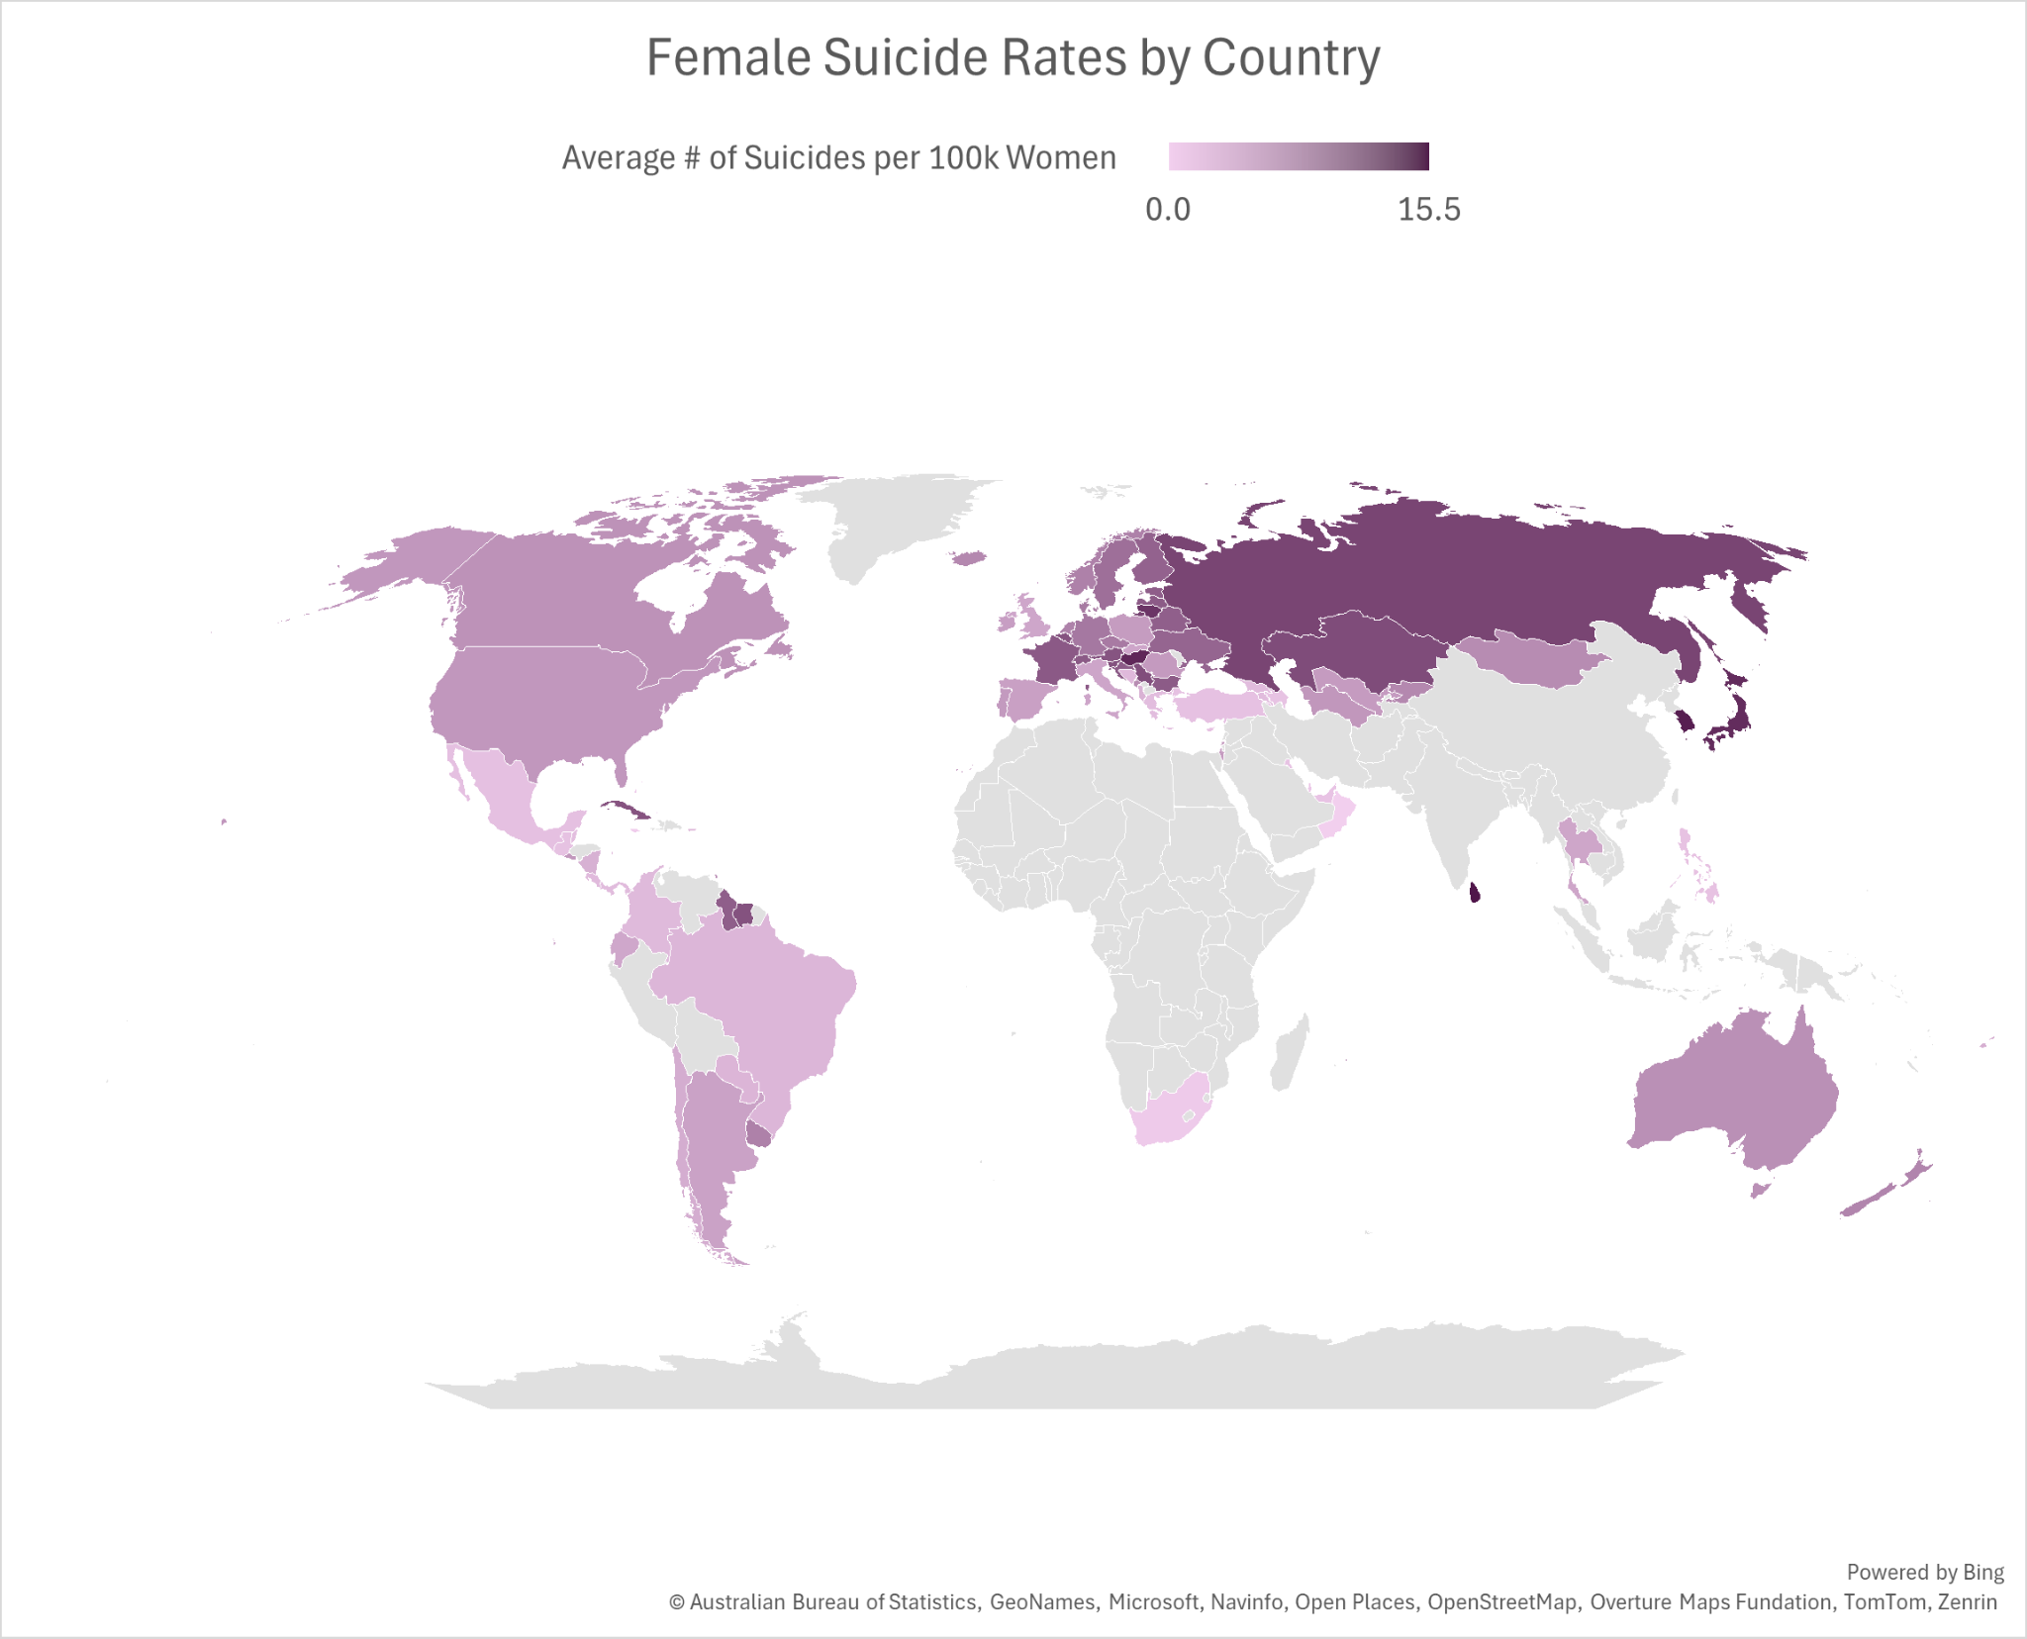
Women Suicide Rates by Country
Top Countries:
Sri Lanka (15.5)[4]
Civil war (1983-2009)
Change in gender norms
Under-resourced mental health resources
Republic of Korea (S.Korea) (14.8)[5]
High levels of depression and anxiety
Societal stigma on mental health
Burdens of progressive and traditional expectations
Hungary (14.1)[6]
Untreated mental health
lack of mental health resources
Lithium/Arsenic in drinking water
Smoking/Drinking

Slide 5
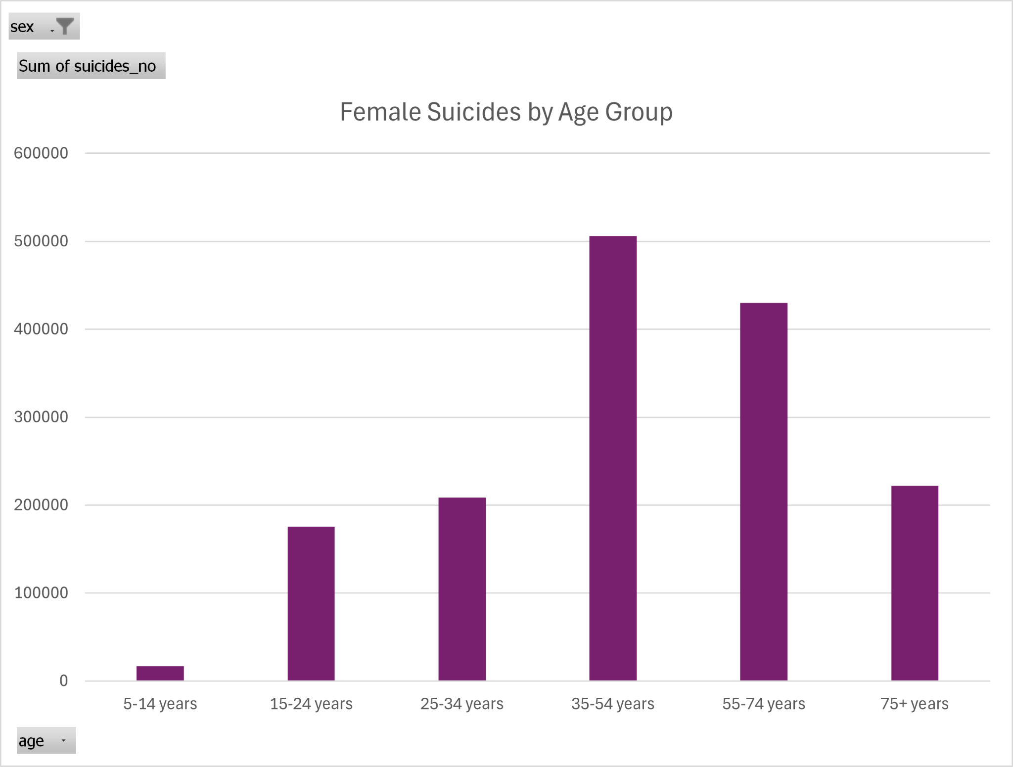
Women Suicides by Age Group (Generation)
Results:
Highest: 35-54: ~510,000 (33%)
Lowest: 5-14: <17,000
Bell Curve: Increases to middle age and then decreases.
Reasons for these trends:[7]
Middle-aged women suffer gender inequality at home and work
Increased chronic pains
Hormonal imbalance/menopause
Decline of mental, physical, and emotional health

Slide 6
Conclusion
Female suicide is not limited by country, age, or generation.
Female suicides are high in countries that apply pressure to gender norms and do not have adaquate mental health resources
Middle aged women make up 30% of all deaths by suicide of women, factors such as decline in health, chronic pain, and hormonal imbalances/menopause.
Note: Future research would benefit from understanding the reasons women and girls commit suicide. Little research was found on this, with most suicidal factors being non-gendered.

Slide 7
References
[1] Office of the Director of National Intelligence. (2021). Global Trends 2040. https://www.dni.gov/index.php/gt2040-home/gt2040-deeper-looks/future-of-womens-rights
[2] UN Women. (2012). 2011-2012 Progress of the World’s Women. In Pursuit of Justice. https://www.unwomen.org/sites/default/files/Headquarters/Attachments/Sections/Library/Publications/2011/ProgressOfTheWorldsWomen-2011-en.pdf
[3] World Economic Forum. (2025). Global Gender Gap Report 2025. https://www.weforum.org/publications/global-gender-gap-report-2025/digest/
[4] Bandara, P., Wickrama, P., Sivayokan, S., Knipe, D., Rajapakse, T. (2024). Reflections on the trends of suicide in Sri Lanka, 1997–2022: The need for continued vigilance. PLOS Glob Public Health. 4(4). https://doi.org/10.1371/journal.pgph.0003054
[5] Lee. A.R., Sun, J.Y.H, Baik, M., Na, P.J., Lee, S.M., Paik, J.W. (2025). National Trends and Directions for Suicide Prevention Research in South Korea: A Narrative Review. Psychiatry Investig. 22(6). 603-6011. doi: 10.30773/pi.2024.0383
[6] Rihmer, Z., Dome, P., Gonda, X., Belteczki, Z., Nemeth, A., Szilagyi, S., Balazs, J. (2022). Decreasing suicide mortality in Hungary – What are the main causes?. Eur Psychiatry. 65. https://doi.org/10.1192/j.eurpsy.2022.342
[7] MGH Center for Women’s Mental Health. (2020). Suicidality in Midlife Women: A Brief Overview. https://womensmentalhealth.org/posts/suicidality-midlife/

